Slide 1

DriverPass System Analysis
Nicholle Caudy
Notes:
[No speaker notes required for this slide.]

Slide 2

System Requirements
Functional Requirements
The system shall validate user credentials when logging in.
The system shall provide all updated and relevant learning materials from the DMV
Non-Functional Requirements
The DriverPass system will run on PCs, Macs, and smartphones.
The system will need to be able to handle and update the test progress and noted entered for each user. As well as keeping the schedule updated and any user information that may change.
Notes:
For the functional requirements, the system will validate the user’s credentials when they log into the system to ensure the user is getting their information and validate the password to protect each user’s information. The DMV will update the system with all relevant policies, rules, and questions for a driving exam. This is essential because DriverPass is striving to provide a service to help individuals pass their driving exams and on-the-road tests. The non-functional requirements will include the DriverPass system to run on PCs, Macs, smartphones, and any device that has internet access capabilities. This is necessary because the system will be a web-based application with a preference for running over the cloud. Running on the cloud will allow the administrator to access and compile reports for DriverPass. The system will need to be able to handle the updates for test progress and instructor notes as well as scheduling updates to allow the customers the best experience and have all relevant information available to them with every login.

Slide 3
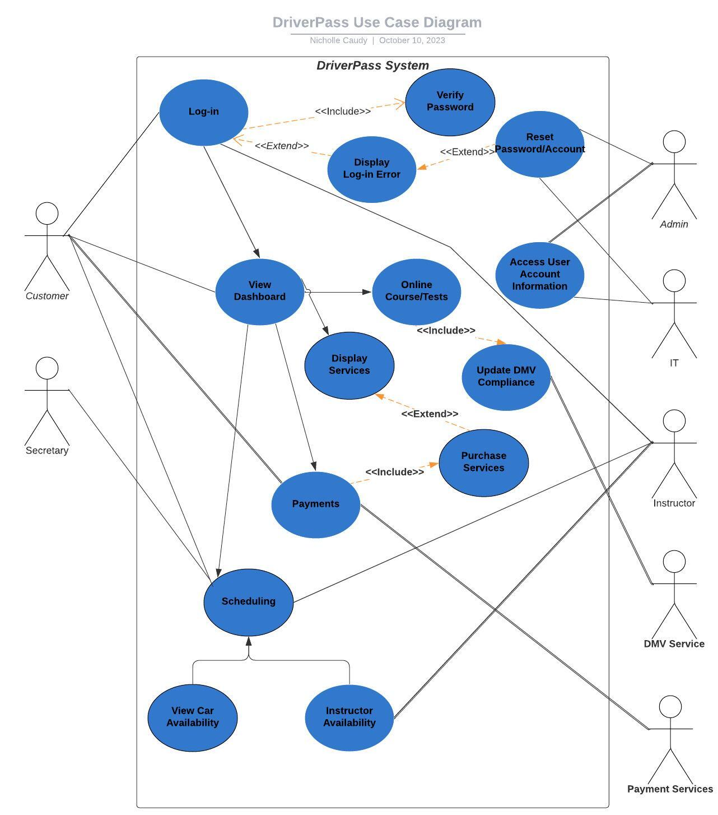
Use Case Diagram
Notes:
This diagram shows all the different users and how they will interact with the system. The Customer will log in and be able to look at their Dashboard where they will have access to the instructor notes as well as their test progress and class information. This will also allow them to schedule their on-the-road driving practice with an instructor. The Secretary interacts with the system by helping the customer schedule their appointments. The scheduling process with verify the availability of a car and instructor before scheduling the appointment. The Administrator will have the ability to access user account information to allow for the deletion of users if required and reset accounts and passwords as needed. The IT user will have the same access to help the administrator keep the system running and reduce clutter in the background of the system. The Instructor will be able to log in to update their notes for their student’s on-the-road instruction. They will also need to keep their scheduling availability updated and see when they are scheduled to take out a student. The Payment Service will interact with the system by processing payments for the package the customer has chosen.

Slide 4
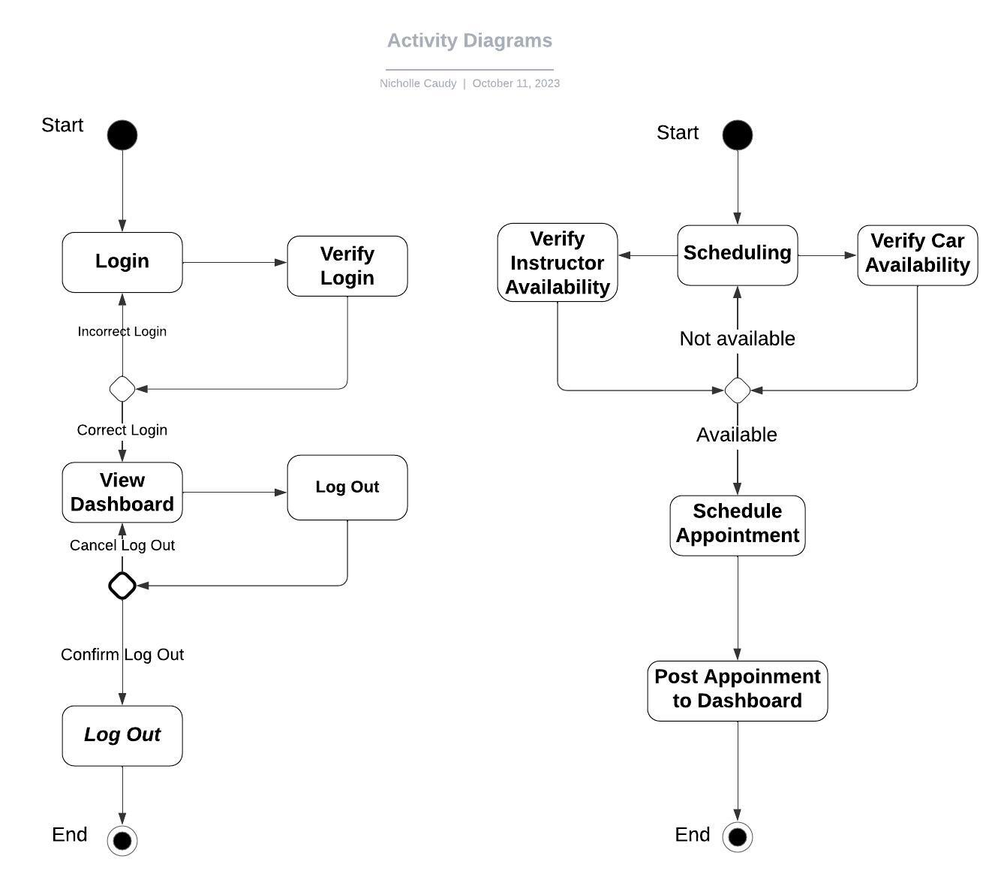
Activity Diagram
Notes:
The activity diagram on the left breaks down the process of logging into the system. The user will insert their credentials, the system will verify that the correct credentials were entered. If there is a mistake the user will be able to try again. If the credentials are entered correctly the user will have access to their dashboard. When the user is finished with their tasks, they can log out with a confirmation that they do want to log out thus leaving the system. The activity diagram on the right breaks down the scheduling process. The scheduling process will verify instructor availability and car availability. When this availability is confirmed, the appointment will be scheduled and posted on the dashboard to keep the users informed.

Slide 5
Security
The user will be required to have a unique username and “strong password.” This password will be case-sensitive and require 8+ characters, at least one of those characters needs to be uppercase, at least one special character or symbol.
Data transfers will be transferred through HTTP over TLS to ensure data is transferred securely
The user will have 3 attempts to enter their login information correctly. After the third failed attempt their account will be locked out and they will be required to contact IT for a password reset. This should prevent any “brute force” hacking attempts.
The system will also offer a “forgot password” link that will require a correct secret question answer to change the password.
Notes:
Security for this system is very important because it will be storing personal information for both the customer and employees. The users will be required to have a unique username, the system will inform the new users if the username they have selected is already in use so they can try again. Having a strong password for the users is essential to avoid any attempts of hacking to gain personal information. These passwords will be case-sensitive, and require 8+ characters, at least one of those characters needs to be uppercase, and at least one special character or symbol. Data transfers also need to be securely moved to avoid any leak of personal/payment information. The system will allow for 3 attempts to log in after the third failed attempt the system will lock that user’s account until they have contacted IT. This will prevent any “brute force” hacking which is when an individual will have unlimited attempts to gain access to an account. The system will offer a “forgot password” link so the user can reset their own password. They will need to answer a secret or security question correctly to have access to reset their password. This will prevent anyone else from changing the user’s password to gain access to the personal information.

Slide 6
System Limitations
The time frame may prove to be a limitation if the team size is small in comparison to what needs to be completed. Putting together a full system in a short amount of time with a small team could lead to some features being cut out or minimized.
Bandwidth availability is also a limitation. Depending on the host database’s allotted bandwidth, the interface may need to be adjusted to account for a lower available bandwidth with less animation and smaller pictures.
The budget or the system has not been discussed but this can also be a limitation. If there are budget constraints this will need to be addressed and adjustments may need to be made to renegotiate requirements.
Depending on how frequently they update our system, getting up-to-date information from the DMV may also be a limitation.
Having the available staff for slotted/desired timeframes for driving lessons/tests.
Notes:
There are some potential system limitations here. The timeframe can be a limitation if the team size does not meet what is required. We need to have a team big enough to handle all the requirements to make the system run smoothly and as desired. Bandwidth or how much digital information can be sent or received across a connection in a certain amount of time, can be a limitation because if a user has lower bandwidth capabilities the system may not run properly for them. To combat this, we need to look at less animation or smaller pictures for those individuals. The budget constraints are a limitation as well. A budget meeting needs to be held to address any issues and renegotiate requirements as needed. Having all the updated information from the DMV can also be a limitation based on how frequently they will be updating our system with all the relevant information. A staffing limitation may also be present. There can be certain times of day or a day of the week that are more popular than others so having the staff to cover those times can be a limitation that needs to be addressed.

